Slide 1
Introduction to DevOps
Sonika Rathi
Assistant Professor
BITS Pilani

Slide 2
Agenda
Selenium - Test Automation
Introduction
Test login page – example
Selenium Components
Selenium History
Selenium Supports
Selenium Architecture
Selenium Benefits

Slide 3
Selenium - Test Automation
Introduction
Selenium helps to automate web browser interaction
Scripts perform the same interactions that any user can perform manually
Selenium can perform any sort of automated interaction; however it was originally designed for automated web application testing
Common benefits of Test Automation:
Frequent regression testing
Rapid feedback to developers
Virtually unlimited iterations of test case execution
Support for Agile and extreme development methodologies
Disciplined documentation of test cases
Customized defect reporting
Finding defects missed by manual testing

Slide 4

Selenium - Test Automation
Example
Test Script
Test Login Page
Se Lib
Enter User ID
User Id
Enter Password
Password
Click Login Btn
Login

Slide 5
Selenium - Test Automation
Working with Selenium
At a high level you will be doing three things with Salenium
First Name*
1. Recognize web elements
Last Name
Email Id*
DOB*
Create Account
Cancel
Input
Select
click
2. Add Actions (Script using preferred lang)
Test Data
3. Run the Test

Slide 6
Selenium - Test Automation
Selenium Components
Selenium IDE
A Record and playback plugin for Firefox add-on
Prototype testing
Selenium RC (Remote Control)
Also known as selenium 1
Used to execute scripts (written in any language) using Javascript
Now Selenium 1 is deprecated and is not actively supported
WebDriver
Most actively used component today
An API used to interact directly with the web browser
Is a successor to Selenium 1 / Selenium RC
Selenium RC and WebDriver are merged to form Selenium 2
Selenium Grid
A tool to run tests in parallel across different machines and different browser simultaneously
Used to minimize the execution time

Slide 7
Selenium - Test Automation
Selenium Components Contd..
Selenium
IDE
RC
WebDriver
Grid
Record & Playback
Execution by JavaScript
Execution by API
Parallel & Distributed Execution

Slide 8
Selenium - Test Automation
Selenium History
Selenium is a set of different software tools each with a different approach to support test automation
Selenium support executing one’s tests on multiple browser platforms
Selenium first came to life in 2004 when Jason Huggins was testing an internal application at ThoughtWorks
It started with a Javascript library
In 2006 at Google, Simon Stewart started work on a project WebDriver
The merging of Selenium and WebDriver provided a common set of features for all users and brought some of the brightest minds in test automation under one roof in 2009

Slide 9
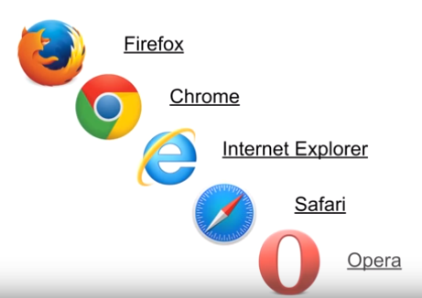

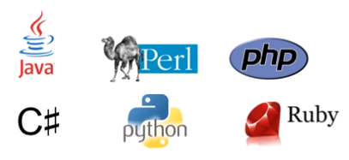
Selenium - Test Automation
Selenium - Supports
Browsers
OS
Language

Slide 10
Selenium - Test Automation
Selenium client-server architecture
Selenium Client includes:
The WebDriver API, which is used to develop test scripts to interact with page and application elements
The RemoteWebDriver class, which communicates with a remote Selenium server
Selenium Server includes:
A server component, to receive requests from Selenium Client 's RemoteWebDriver class
The WebDriver API, to run tests against web browsers on a server machine
Selenium Grid, implemented by Selenium Server in command-line options for grid features

Slide 11
Selenium - Test Automation
Selenium Grid
Se Lib
iPad
M
Windows 10
Mac OS
CentOS

Slide 12
Selenium - Test Automation
Benefits
Faster Feedback
It enhances communication between product owners, developers and designers
Quick fix of malfunctions & bugs in real-time
Accelerated Results
Testing can be executed on a repetitive basis, which in turn will deliver speedier results every time with minimized time and reduced effort
Reduced Business Expenses
Time needed to execute tests will decrease dramatically
Larger quantity of work can be undertaken in the same amount of time with greatly increased levels of accuracy
This will directly reduce project costs

Slide 13
Selenium - Test Automation
Benefits Contd..
Testing Efficiency Improvement
Testing occupies a considerable part of the whole Software Development Lifecycle
So even the smallest improvement in the overall efficiency can result in a massive difference to the overall project timeline
Reusability of Automated Tests
Earlier Detection of Defects
Early defect detection leads to cost-effective code rework
Faster Time-to-Market
Time to market is a critical factor in product planning and success with regard to software applications
Efficiency of test automation will reduce the time of project; which results you to hit market early

Slide 14
References
https://www.seleniumhq.org/docs/index.jsp/

Slide 15
Thank You!
In our next session:

